Slide 1
Stock Analysis and Visualization
A Python-Based Visualization Tool
Name : Manish kumar
Uid : 21BCS9855
Section:Iot-640/B

Slide 2
Library Used:
yfinance for data retrieval.
numpy for numerical computations.
matplotlib for data visualization.
tkinter for creating the graphical user interface.

Slide 3
Work flow :
Data fetching with yfinance.
Calculation of technical indicators.
Visualization of stock data.
User interaction facilitated by a Tkinter GUI.

Slide 4
Key Points
Data Analysis: Analyze historical stock data using Python.
Technical Indicators: Calculate RSI and MACD for comprehensive technical analysis.
Visualization: Visualize stock trends through informative plots with matplotlib.
User-Friendly Interface: Develop an interactive Tkinter GUI for user input and customization.

Slide 5
Benefites:
Informed Decision-Making: Gain insights into stock trends to make informed investment decisions.
User Empowerment: Empower users with a user-friendly interface to explore and analyze stock data.
Educational Value: Serve as an educational tool to enhance understanding of technical analysis in finance.
Customized Analysis: Allow users to customize analyses by selecting specific stocks and date ranges.

Slide 6
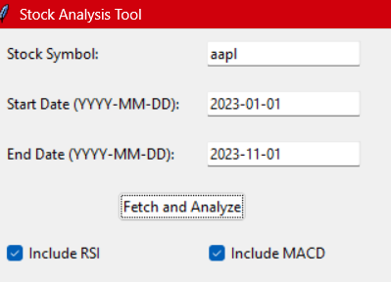
Working:

Slide 7
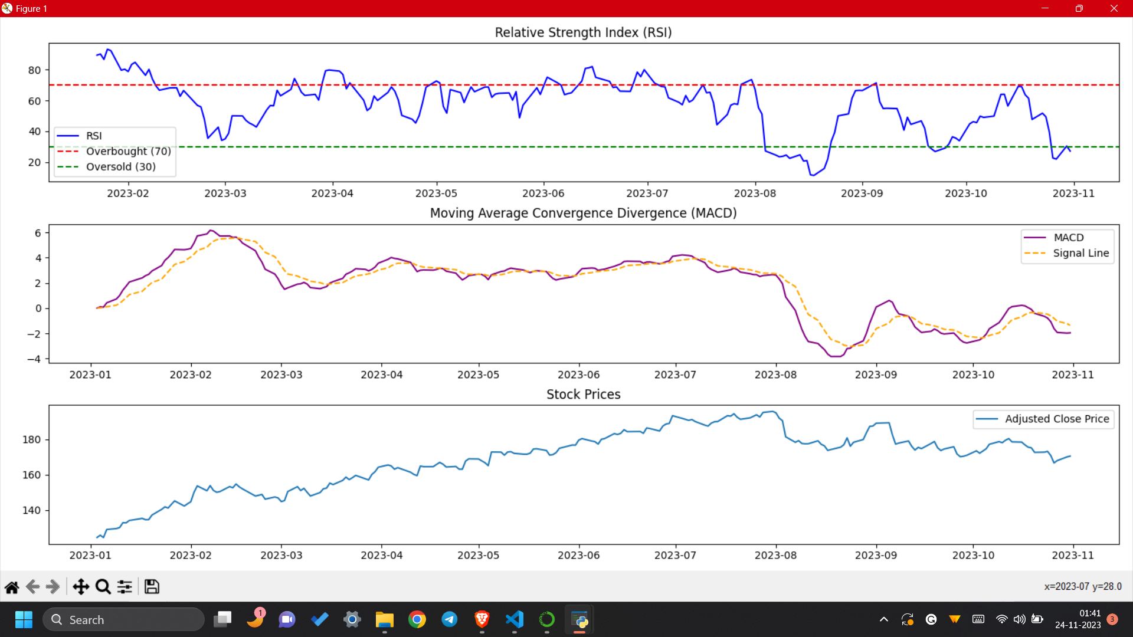
Output:

Slide 8
Thanks you

